Slide 1
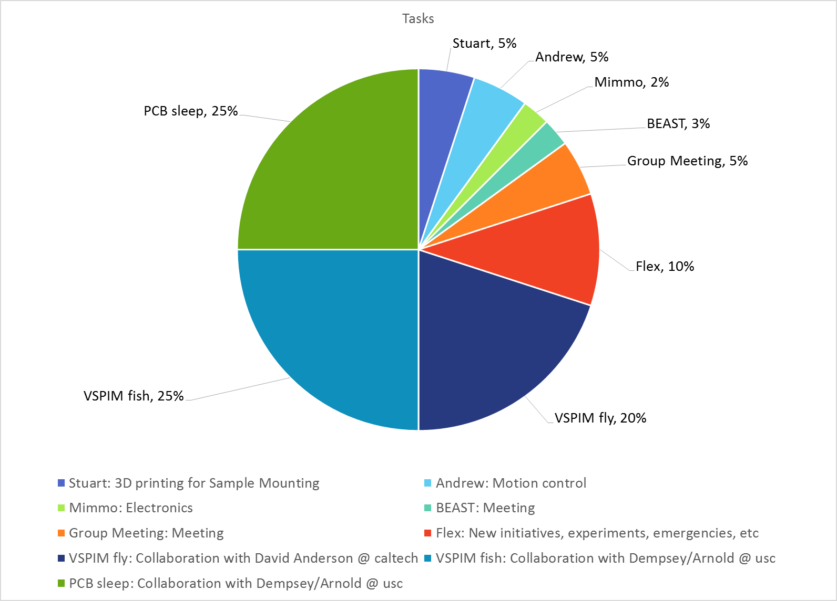
Example: Time Allocation

